Slide 1
Project Based Learning -VI
Team Details: Rahul Mittal(2110993824)
Kangna(2110993804)
Jatin Verma(2110993803)
Branch: BE CSE-AI (Sem-06)
Faculty Coordinator: Dr. Harshvardhan
Chitkara University Institute of Engineering and Technology,
Chitkara University, Punjab

Slide 2

Table of Contents
Introduction
Problem Statement
Technical Details
Key Features
Project Highlights
Conclusion
References/Links used

Slide 3
Introduction
Enhancing Call Center Services Through Sentiment Analysis
Overview
Enhancing call center services through sentiment analysis is a valuable project that leverages natural language processing (NLP) and machine learning techniques to improve customer support interactions and customer satisfaction.
The primary objective of this project is to enhance the quality of customer service in a call center environment by analyzing the sentiment of customer interactions in real-time. By understanding customer sentiment, call center agents can respond more effectively and provide a better overall experience.

Slide 4

Problem Statement
To make a SENTIMENT ANALYSIS System model using Deep Learning in Python which will detect the sentiment of the input audio file.

Slide 5
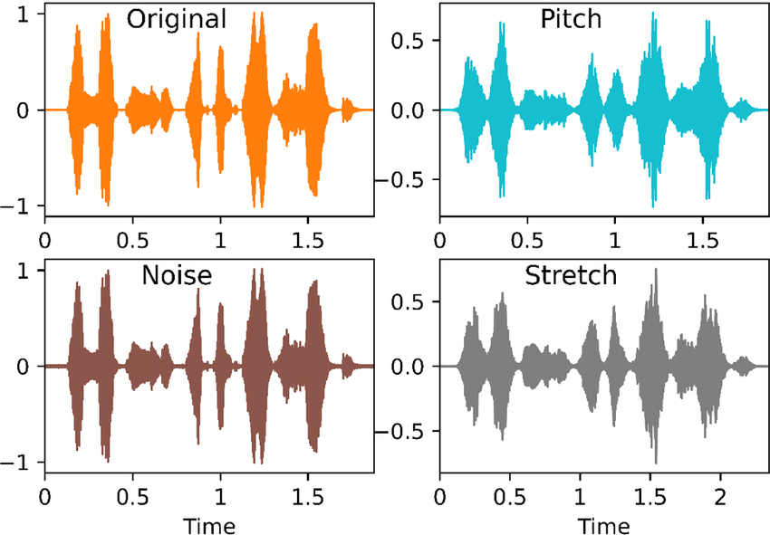
Technical Details
We have used data augmentation in our project. Data augmentation in deep learning is a technique used to artificially increase the size and diversity of a training dataset by applying various transformations or modifications to the original data. The primary goal of data augmentation is to improve the generalization and robustness of deep learning models, reducing overfitting and helping models perform better on unseen or real-world data. Data augmentation is widely used in computer vision, natural language processing, audio processing, and other domains where large and diverse datasets are essential.

Slide 6
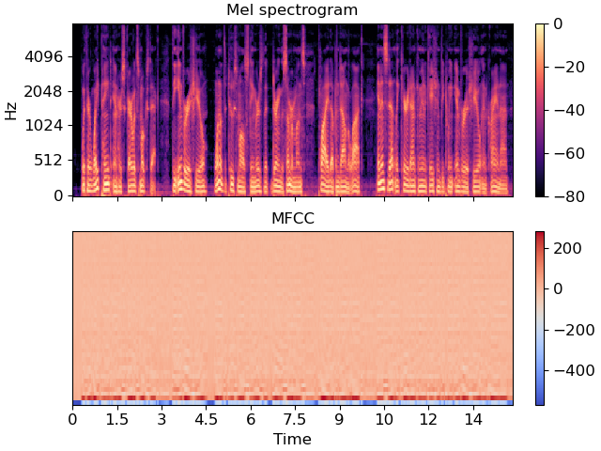
We have used three audio features. Using audio features such as Zero Crossing Rate (ZCR), Root Mean Square Error (RMSE), and Mel-frequency Cepstral Coefficients (MFCCs) for sentiment analysis in deep learning on audio datasets serves several purposes:

Slide 7
Key Features
Capture Acoustic Characteristics: These audio features capture various acoustic characteristics of the audio signals, which can contain valuable information related to sentiment. ZCR, RMSE, and MFCCs provide insights into aspects like pitch, loudness, and spectral content, which can be indicative of emotions and sentiments expressed in speech.
Diversity of Information: Audio data is multimodal, meaning it contains both textual (words) and acoustic (speech) information. By incorporating audio features alongside text-based features, deep learning models can potentially leverage a broader range of information to improve sentiment analysis accuracy. This is particularly valuable when dealing with spoken language data.
Feature Engineering: These audio features serve as engineered representations of the audio data. Deep learning models often benefit from having well-defined input features, especially when the amount of data is limited. ZCR, RMSE, and MFCCs provide a structured way to represent audio signals.

Slide 8
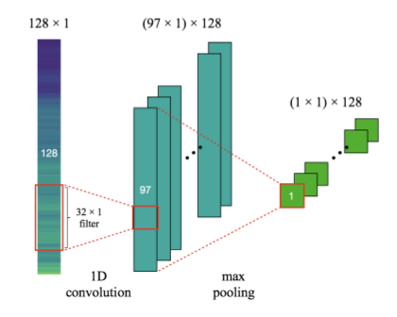
CNN in NLP
We have used CNN model with one convolutional layer
When using Convolutional Neural Networks (CNNs) for sentiment analysis of audio data, you can adapt a similar architecture to the Conv1 model for image classification, with some modifications to handle audio data. The primary difference is in the input data and preprocessing.

Slide 9
Using a Convolutional Neural Network (CNN) with a single convolutional layer (Conv1) for sentiment analysis of audio datasets can be beneficial for several reasons:
Feature Extraction: CNNs are well-suited for extracting hierarchical and localized features from data. In the case of audio data, the initial convolutional layer(s) can capture low-level features such as spectral patterns, edges, and transient audio events. These features may be relevant for discerning different sentiments in audio signals.
Automatic Feature Learning: CNNs can automatically learn relevant features from the raw audio data, reducing the need for handcrafted feature engineering. This is particularly advantageous when working with audio datasets where extracting meaningful features manually can be challenging.
Hierarchical Learning: CNNs consist of multiple layers, including convolutional, pooling, and fully connected layers. This hierarchical architecture enables the network to learn increasingly abstract representations of the input data, potentially capturing more complex patterns related to sentiment in higher layers.

Slide 10
4.Local and Global Patterns: The initial convolutional layer(s) in a CNN can capture local patterns in audio data, such as short-duration acoustic cues associated with sentiment expression. These local patterns are then combined in subsequent layers to identify global patterns and relationships in the audio data.
5.Parallel Processing: CNNs can process different parts of the audio data in parallel, making them efficient for analyzing audio signals with varying temporal patterns. This parallelism allows the network to capture both short-term and long-term audio characteristics simultaneously.
6.Scalability: Conv1 models are relatively simple compared to more complex CNN architectures. They are computationally efficient and may require fewer parameters and training data, making them suitable for smaller audio datasets.

Slide 11
It's important to note that while Conv1 models can be effective for certain sentiment analysis tasks on audio data, the choice of architecture should be guided by the specific characteristics of your dataset and problem. More complex CNN architectures, recurrent neural networks (RNNs), hybrid models, or transformer-based models may be more suitable for audio data with longer sequences or complex temporal dependencies.
Ultimately, the choice of model architecture should be based on empirical experimentation, considering factors like dataset size, data representation (e.g., raw audio, extracted features), and the nature of the sentiment analysis task.

Slide 12
Conclusion
In conclusion, enhancing call center services through sentiment analysis is a valuable approach to improving customer satisfaction, agent performance, and overall service quality. Real-time analysis, automation, and the extraction of customer insights are key benefits of this project. As customer interactions continue to evolve across various communication channels, sentiment analysis will play an increasingly important role in delivering exceptional customer experiences.
Future Directions
The future directions of a project enhancing call center services through sentiment analysis involve embracing multimodal analysis, such as voice sentiment, customized responses, and emotion recognition. Real-time actions driven by sentiment, predictive analytics, domain-specific models, and advanced visualization tools will enhance customer experiences. Ensuring data security, feedback mechanisms, multilingual support, and ethical AI considerations will be pivotal as call centers evolve to meet the changing demands of customer interactions across various channels.

Slide 13
References/Links used
Wikipedia
TowardsDataScience
Dataset:- CREMA from kaggle

Slide 14


